Slide 1
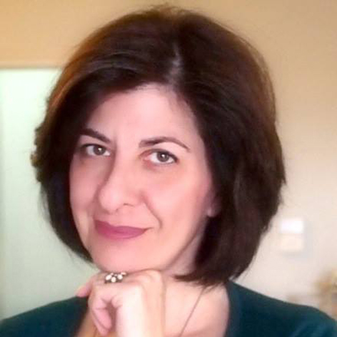
Children’s rights and inclusive education: From academic research to teacher support and school interventions
Sofia Avgitidou, Professor, Aristotle University of Thessaloniki, Greece

Slide 2
Children’s rights and inclusive education: From academic research to teacher support and school interventions
Sofia Avgitidou Professor of Pedagogy – Teacher Education Head of KERYSDE,
Department of Education School of Philosophy and Pedagogy,
Aristotle University of Thessaloniki, Greece

Slide 3
Aims of the presentation
Child Rights Centres and academic research
What is the research knowledge we need to support children’s rights in education?
How can the research knowledge be transformed to empower teachers’ communities for the creation of inclusive environments for every child? – sharing methodologies, materials and processes

Slide 4
Concerns and suggestions
Democracy – children's voices Article 12 of the Convention on the Rights of the Child – how to enhance children's participation in decision-making
01
School Culture – what are the relationships and culture at school and how can we co-shape a whole school community collaboration through inquiry and reflection?
02
Diversity - Cooperation – Professional learning How do we educate/support the facilitators of teachers' professional learning communities?
How do we support inclusive schools?
03

Slide 5
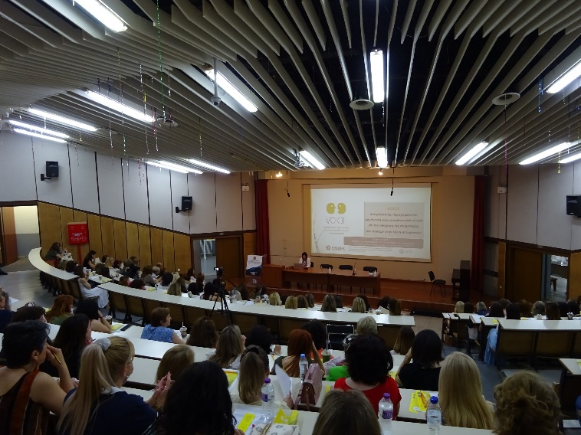
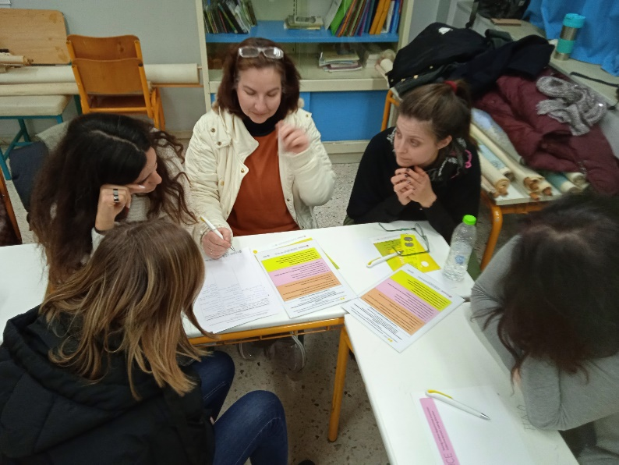
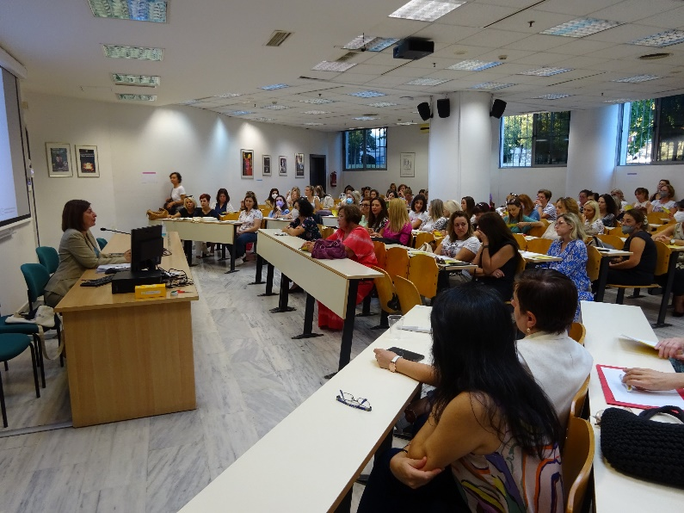
The VOICE program – enhancing opportunities for children’s participation in decision making in education
Disseminating research to the educational community
More than 1000 ECE teachers participated in seminars and workshops from 6 different educational regions
Transforming research into open digital educational materials
http://voice.web.auth.gr/en (english version)
Αρχική | Drupal (auth.gr) (greek version)

Slide 6
The Democratic School yearly workshop

Slide 7
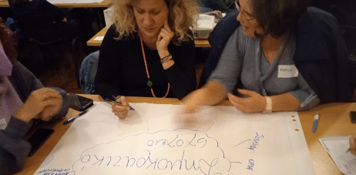
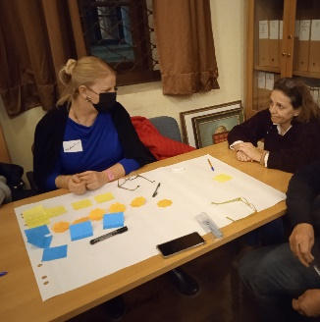
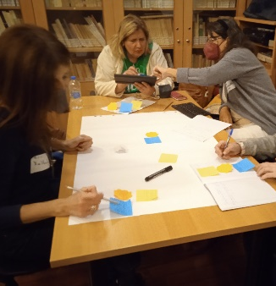
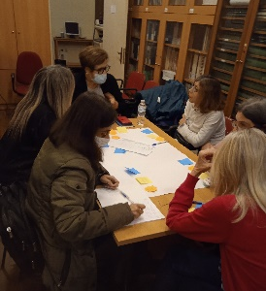
1st meeting
Exchanging views and practices about the democratic school through mind maps and dialogue

Slide 8
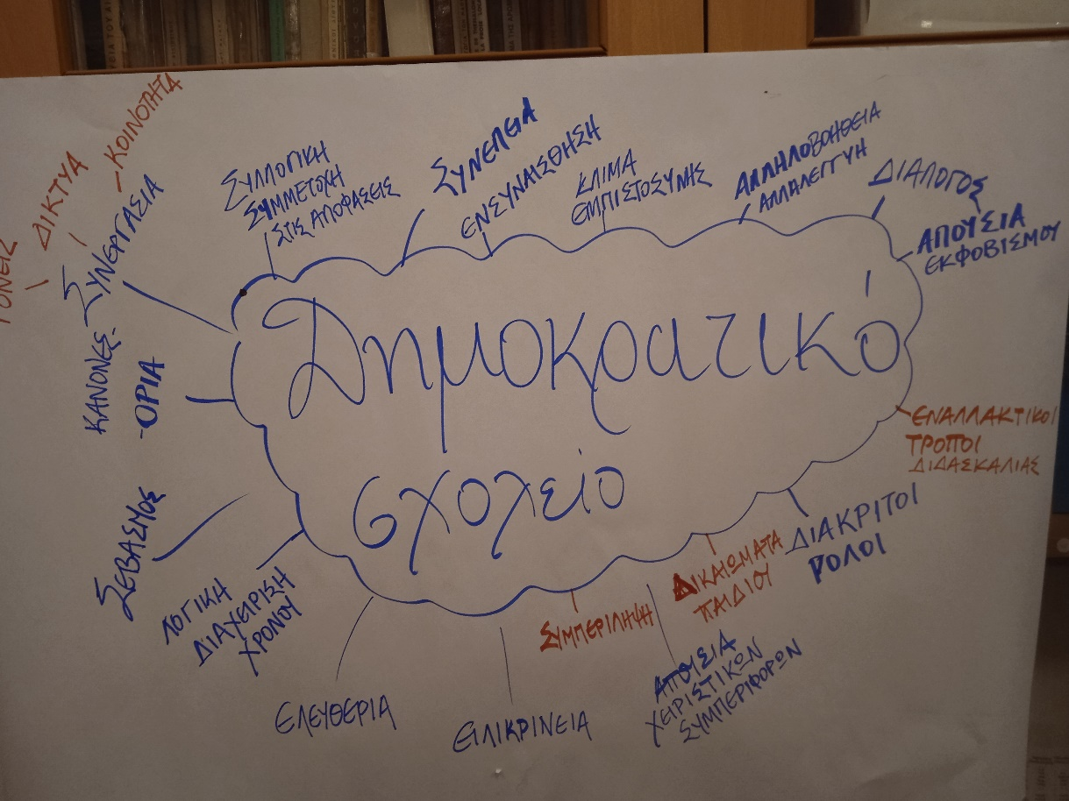
STARTING POINTS | MEANINGS
Desire to learn, to cope, to acquire practices, to identify, to implement I believe in democratic school – I want to strengthen it | INCLUSION FREEDOM OF EXPRESSION - DIALOGUE POSSIBILITY OF CO-DECISION EQUAL OPPORTUNITIES PARTICIPATORY DECISION-MAKING

Slide 9
Reflective questions: communication, pedagogical relationship and dialogue as prerequisites for a democratic school
How much do we know our students? Do we know anything about each and every one? Are we satisfied with the relationships we have developed with our students? Is there room for improvement in the relationships we have developed with them? How often and in what ways do we give opportunities to our students to express their opinions, feelings and suggestions? How do our students respond? For which things could students express an opinion on and co-shape teaching?

Slide 10
EXPLORING STUDENTS’ VOICES A purposeful and systematic inquiry to design informed actions
HIGH SCHOOL What do I like about school and why? What don't I like and why? What do I want to change? How can what I propose change? LYCEUM What does a democratic school mean to you? What are the issues that concern you in relation to the democratic functioning of our school? What would you suggest in order to strengthen our school as a democratic school?

Slide 11
Examples of students’ responses Teaching and learning
Teachers should not choose who they want to listen to, but listen to everyone and find a fair solution.
Many teachers target "bad" students and keep making them say the lesson or tell them they don't do homework.
Many children don't feel comfortable or are afraid to ask about the lesson they're not good at. The class often criticizes by laughing at you I don't like the pressure of lessons because above all we are children

Slide 12
Students’ proposals
Students and teachers should come together to change the situation for the better. I believe that it takes an hour a week in which a teacher and students could get to know each other better so that the student is not afraid of the teacher Let everyone think that life is not only school but also a little fun. Because we all know that they have gone through the positions we are in now and remember how difficult it is to give us a day “break”. Teachers to help children to have respect for all fellow human beings in their lives. To have authentic relationships, to have mutual respect

Slide 13
But children also have opinions on other issues:
School space The school is quite old... In cases of rain flood classrooms and the gym Space accessibility, a child with a stroller cannot climb the stairs There should be penalties and payment of money if someone breaks or breaks something at school.
School time Start class at 8:45 a.m. Longer breaks I want to change the seven-hour day, to become some 6 and 5 hours

Slide 14
But children also have opinions on other issues:
Program -Ability to choose courses Free choice in attending daily courses To have creative activities, performances, etc. at school
Rules Do not ban mobile phones that do not affect children's performance. I don't like that we can hardly get permission for something (eg excursion) from the manager No limit on absences

Slide 15
But children also have opinions on other issues:
Operation of students’ councils
More action from the students’ councils Whoever gets the most votes should be elected president of the fifteen-member panel. The student council should ask and listen to the opinion of the other students.
Educational system
Change in the education system Less subject matter Course options
They claim part of the power Participate in elections on who is a suitable teacher and headmaster

Slide 16
ACTION PLANS BASED ON INQUIRY AND REFLECTION
FOCUS OF THE ACTION PLANS
A. Getting to know my students – strengthening the pedagogical relationship
B. Getting students to know each other - strengthening the climate of acceptance
C. Teaching – new ways/methods for active student participation
D. Teaching – enhancing dialogue and constructive feedback in the lesson
E. Teaching - alternative ways of assessment

Slide 17
https://www.leafap.eu/
Barcamp (hybrid, Thessaloniki 9th October, 2024), webinars and modular online educational program
Erasmus+ partners:
Weingarten University of Education, Germany
Pädagogische Hochschule Vorarlberg, A
UNIVERSIDAD DE MALAGA, E
EUROPEAN UNIVERSITY CYPRUS, CY
ARISTOTELIO PANEPISTIMIO THESSALONIKIS, GR
NORGES TEKNISK-NATURVITENSKAPELIGE UNIVERSITET NTNU, NO
Centro de Profesorado Marbella – Coín, E
Centro del Profesorado de Málaga, E.
How to educate those who support professional learning communities in educational settings?

Slide 18
ACT and connect for Integration (ACTIN)
The ACTIN project aims to support and reinforce the integration and inclusion of migrant children and adolescents in education and by extension in European society as a whole by bringing together expertise from five European countries and by consolidating connections between Universities and NGOs involved in migration and education.
Coordinator
Aristotle University of Thessaloniki, Greece
Beneficiaries
University of Konstanz, Germany
University of Strasbourg, France
Jagellonian University, Poland
Roscommon Integrated Development Company Limited by guarantee, Ireland
Solidarity Now, Greece
Fundacja Reja, Poland
Associated Partners
University of Geneva, Switzerland
Inn University, Norway

Slide 19
CONCLUDING: Possible roles /actions of the Child Rights Centres in academic institutions
Enacting initiatives to start a dialogue with the students – CHILDREN HAVE IMPORTANT THINGS TO SAY!
Listening to children's voices and harnessing it through dialogue and consultation – BUILDING A COMMUNITY
Supporting teachers as a professional learning community – University / schools collaboration
INQUIRY AND REFLECTION IN PROFESSIONAL LEARNING
Opening margins for teachers’ actions –
SUPPORTING A CHANGE OF EDUCATIONAL POLICIES
Systemic support for children and families –
SUPPORTING SOCIAL POLICIES COMPLEMENTING EDUCATION

